Slide 1
Experiment – 1
PRN : 25070521165
1.1.4 Area of Triangle
Algorithm
STEP 1 : Start
STEP 2 : Input base, height
STEP 3 : Calculate
area = 0.5*base * height
STEP 4 : Print area
STEP 5 : Stop
Flowchart
Start
Input base, height
area = 0.5 * base * height
Print area
Stop

Slide 2
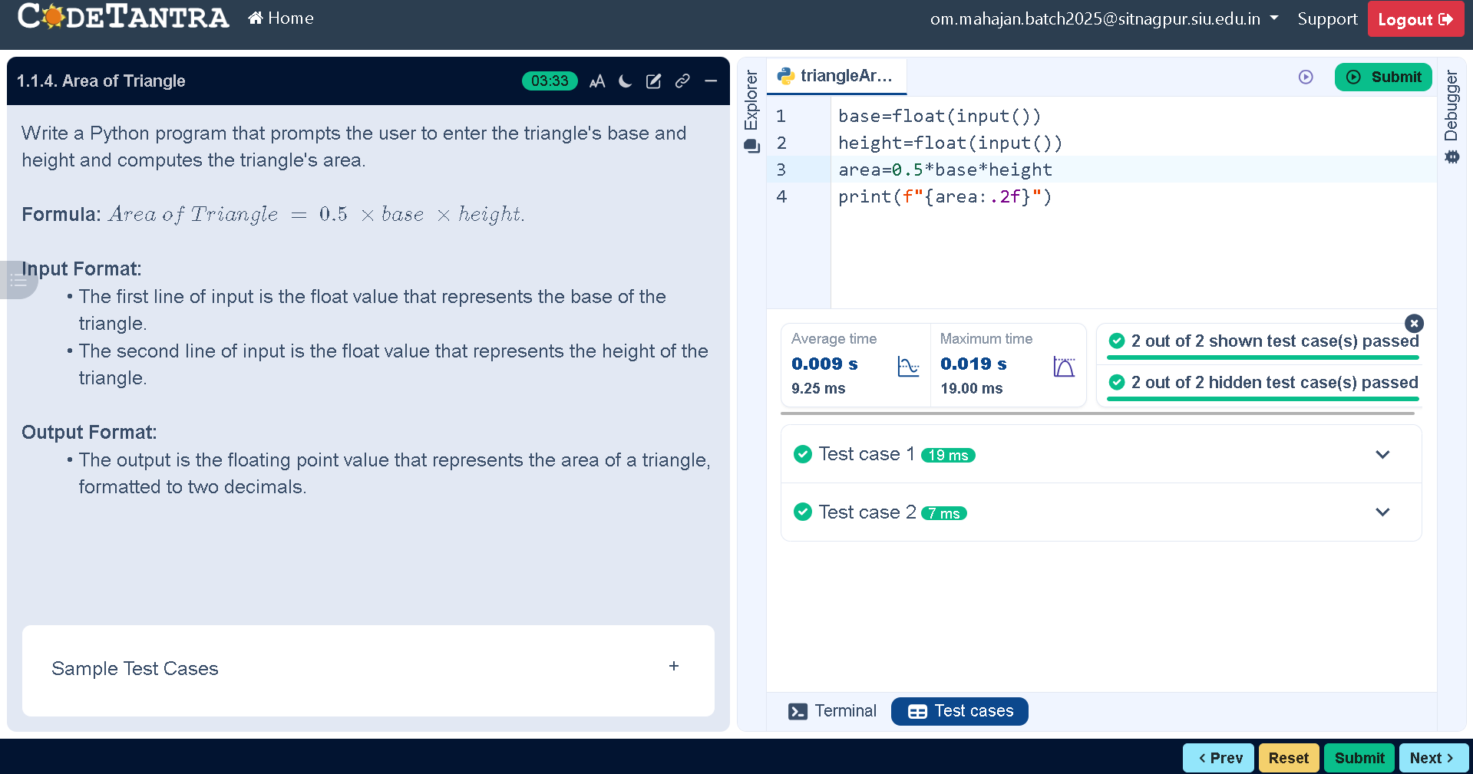
Code
PRN : 25070521165
base=float(input())
height=float(input())
area=0.5*base*height
print(f"{area:.2f}")
Execution

